Slide 1

Enhancing Profitability by Combining Online Sales with Traditional Vendor Channels
IITM Online BS Degree Program
Aaditi Menon
24f1002623@ds.study.iitm.ac.in

Slide 2


ABOUT THE BUSINESS
• Kamalai Organics is a small business located in Yavatmal, Maharashtra, founded in September 2023 by Ms. Sanhita Badki.
• The company specializes in coconut oil infused with organic herbs, particularly Bhringraj, and is recognized locally for its organic hair oil.
• The business primarily targets the B2B segment, supplying products to salons and home-based sellers, often women vendors.
• Prices for the hair oil are set affordably to encourage resale, enhancing economic viability.

Slide 3
CHALLENGES
Excessive reliance on vendor networks and limited direct customer reach
Irregular ordering patterns and fluctuating demand
Problems, effects and related expenses of platform dependency

Slide 4
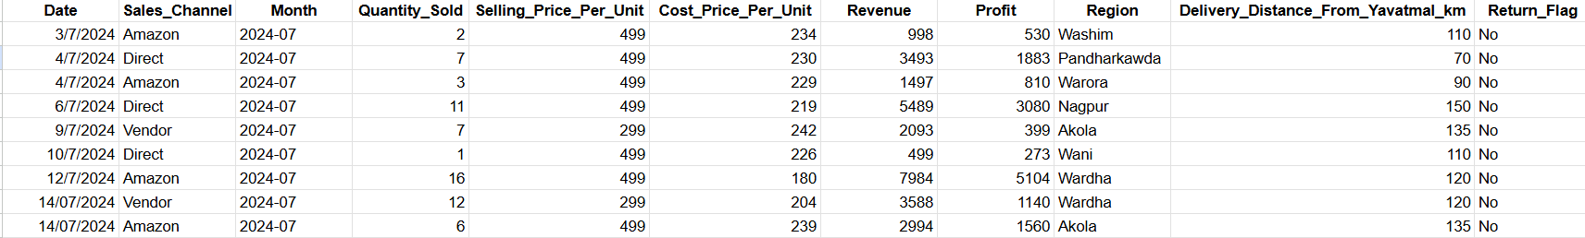
DATASET AND OVERVIEW
The dataset was collected for over 8 months from July 2024 to February 2025.
Features Collected:
Date – July 2024 to February 2025
Sales Channel – Amazon, Vendor, Direct consumer
Quantity Sold – No. of oil bottles sold
Selling Price Per Unit – Price charged per bottle
Cost Price Per Unit – Cost of material, packaging, labour
Revenue – Total sales
Profit
Region – Mostly in Maharashtra
Delivery Distance From Yavatmal (in km)
Return Flag – Product was returned (yes/no)

Slide 5
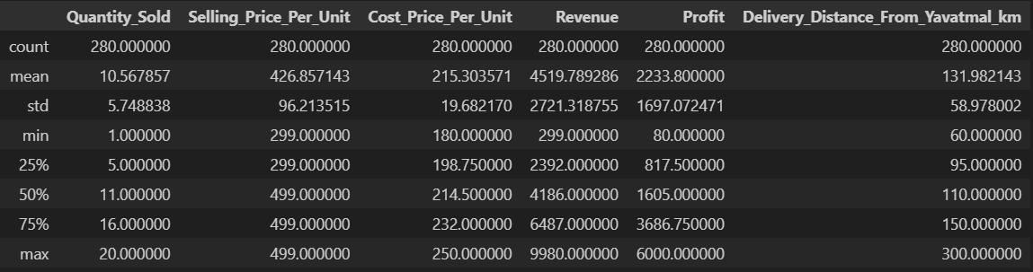
DESCRIPTIVE STATISTICS AND METHODOLOGY
Cleaned and standardized the dataset, fixed inconsistencies in the sales channels and date formats for reliable analysis.
Used Python (descriptive statistics) and Google Sheets to identify outliers and missing values, ensuring accurate results.
Visualized sales trends and vendor ordering patterns using line graphs and box plots in Python.
Held discussions with the business owner to gather practical insights beyond quantitative data.

Slide 6
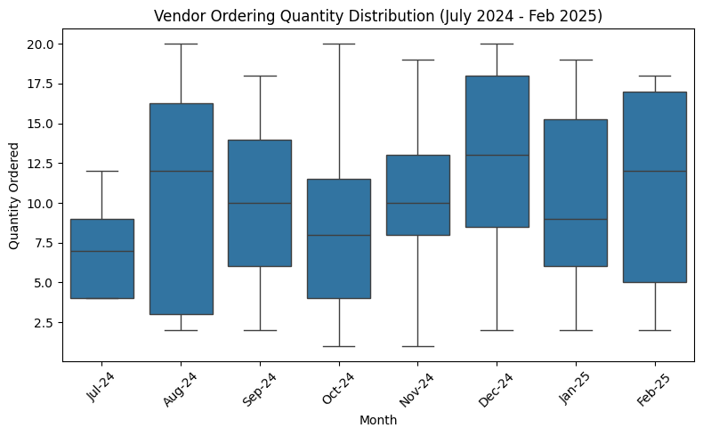
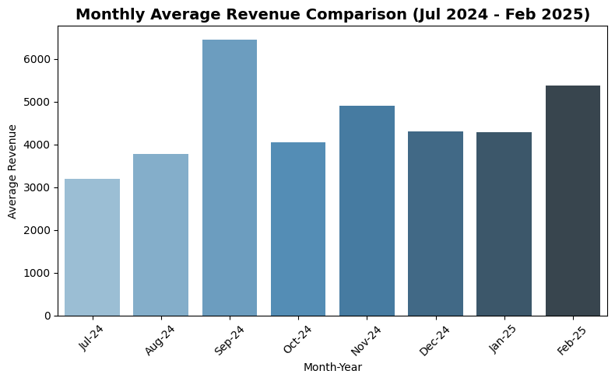
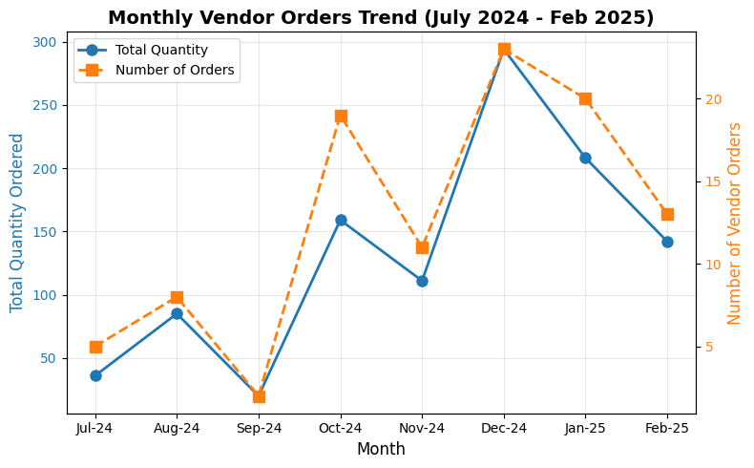
IRREGULAR VENDOR ORDERING AND FLUCTUATING DEMAND OVERVIEW

Slide 7
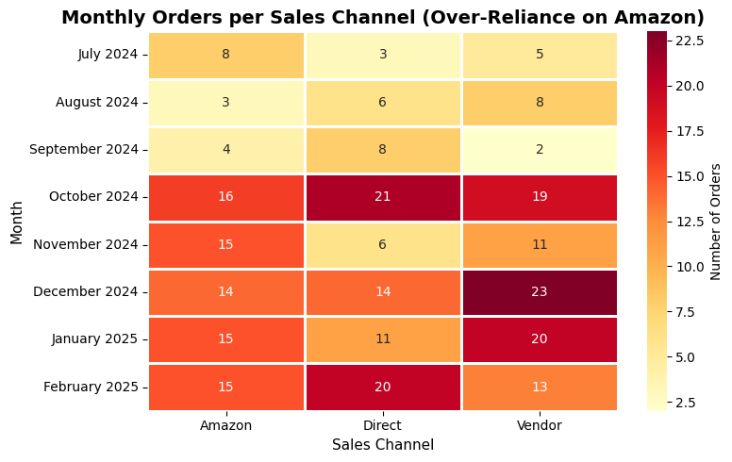
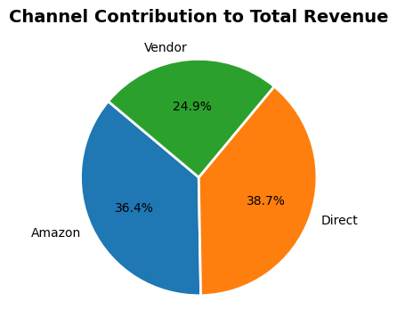
PLATFORM DEPENDENCY
Average Overstock (%)
Average Stockout (%)
Solar panels and mounting hardware frequently experienced overstock situations, while energy storage systems faced critical stockouts.

Slide 8
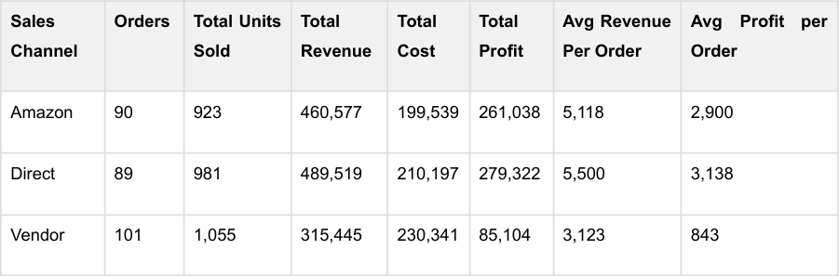
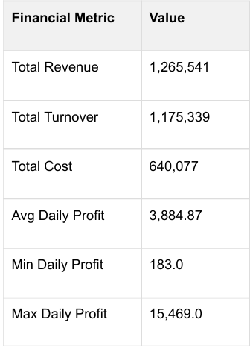
RESULTS AND RECOMMENDATIONS
Perform detailed studying of returns in order to reduce post sale losses and enhance satisfaction of customers.
Invest in high-profit period marketing techniques to earn peak performance and average the daily profit constant with time.
Move strategic focus to grow the order and revenue split with Direct and Amazon where the profitability is much stronger and manage the vendor terms and supply chain contracts optimally to be cost effective.

Slide 9




RESULTS AND RECOMMENDATIONS
Increase Product Line and Channel Diversification
Introduce complementary organic products (shampoo, conditioner, serum) to leverage existing brand trust
Explore offline distribution through local organic stores and community events to reduce e-commerce dependency
Improve Inventory and Demand Forecasting
Set optimal inventory levels based on average sales and lead times to prevent stockouts
Reduce holding costs and ensure timely delivery during peak demand periods
Optimization of Vendor Relationship
Identify and phase out underperforming vendors with irregular ordering patterns
Offer early-payment discounts and volume incentives to reliable vendors
Marketing and Customer Retention
Use social media analytics to optimize ad spending and campaign effectiveness
Launch loyalty programs for repeat Direct channel customers to improve retention

Slide 10
BDM PROJECT
https://drive.google.com/drive/folders/1a1_CyJQTMXQX54ZHC0IPQ8BtwHqbLUKz
THANK YOU!

